Slide 1












AMAZON PRIME EDA
BY AJITHA

Slide 2

Launch Date:
Amazon Prime was first introduced in the United States in 2005. While it wasn't an instant success, it has grown significantly since then.
Customer Growth:
Initially, Prime offered just free two-day shipping. Over time, it expanded to include many other benefits like:
Access to Amazon's streaming service, Prime Video
Exclusive discounts and deals
Free music streaming with Prime Music
Free reading material with Prime Reading
Faster delivery options

Slide 3

INTERPRETATIONS

Slide 4
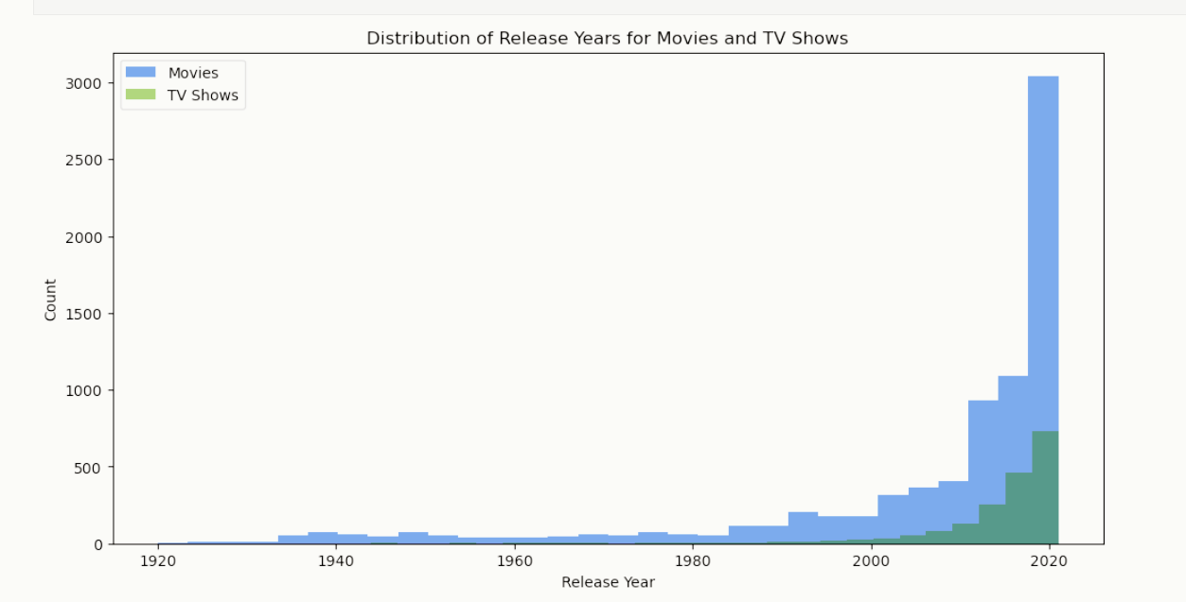
The count of movies or tv shows have significantly increased in the 21st century.The tv shows have been started to be released only after 1950s and increased during the 21st century.

Slide 5
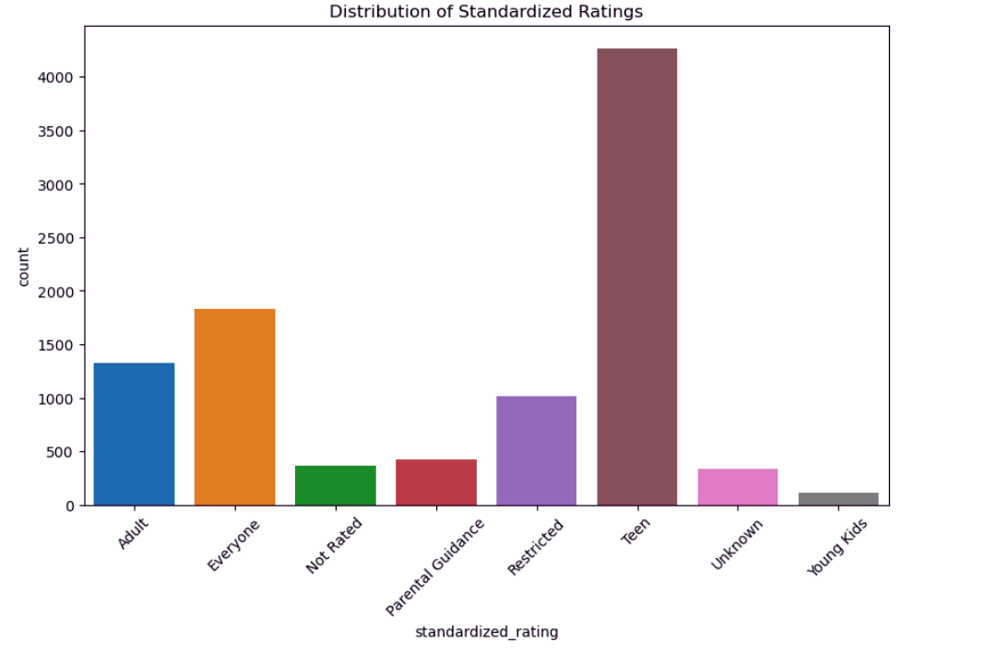
Teen category has the highest counts,so the target audience is teenagers,and which is actually successful

Slide 6
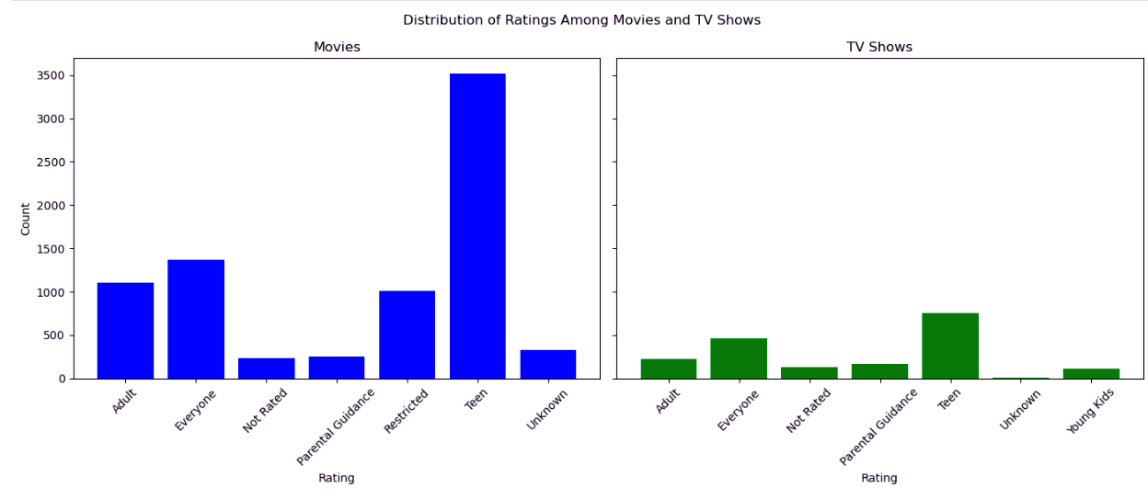
The target was teenagers and the count is also higher for teenagers,this is due to the reason that teenagers are more vulnerable to the social trends and media,and they will be having access to that, with the vulnerabilities,they try to explore all the possible accesses they get unlike adults.

Slide 7
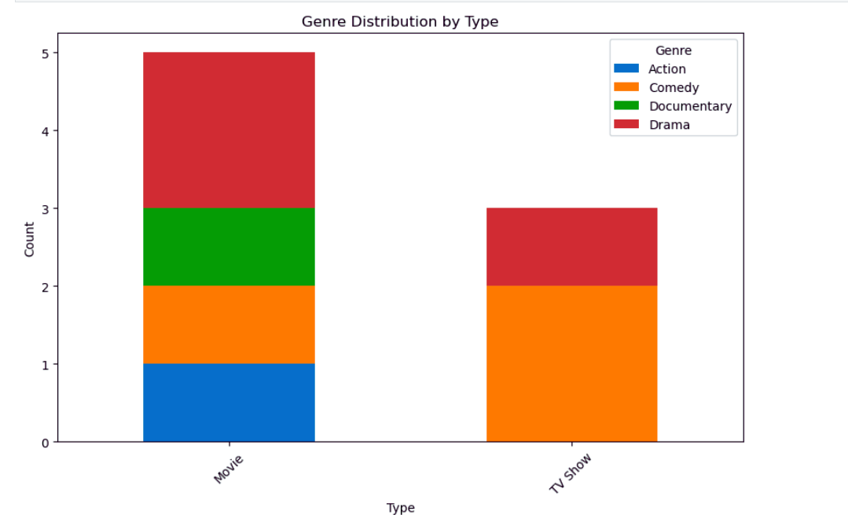
The highest reach is recorded by drame genre followed by comedy.These genres are preferred by the most irrespective of the gender of age. While movies have multiple genre records,tv shows are now blooming and they opt for more preferred genres.

Slide 8
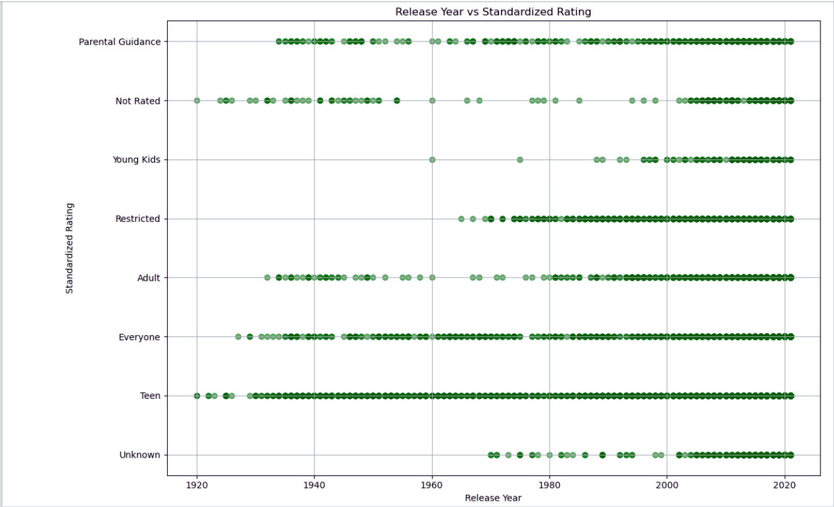

Slide 9
While in the early 20th century, young kids weren’t considered as the target audience,while in the 21st century,all the type of people are targeted by the artists and media. Due to the increased consumption of media, these days all the people irrespective of age are getting access for the media consumption,and hence the arts are made for all type of audience!

Slide 10


























THANK YOU!

